Slide 1

PROJECT ON JOB SEARCH

Slide 2

ABSTRACT
In today's dynamic job market, understanding the intricacies of job search patterns and preferences is crucial for both job seekers and employers. This project employs SQL (Structured Query Language) to analyze job search data and uncover valuable insights into job seekers' behaviors and preferences.

Slide 3
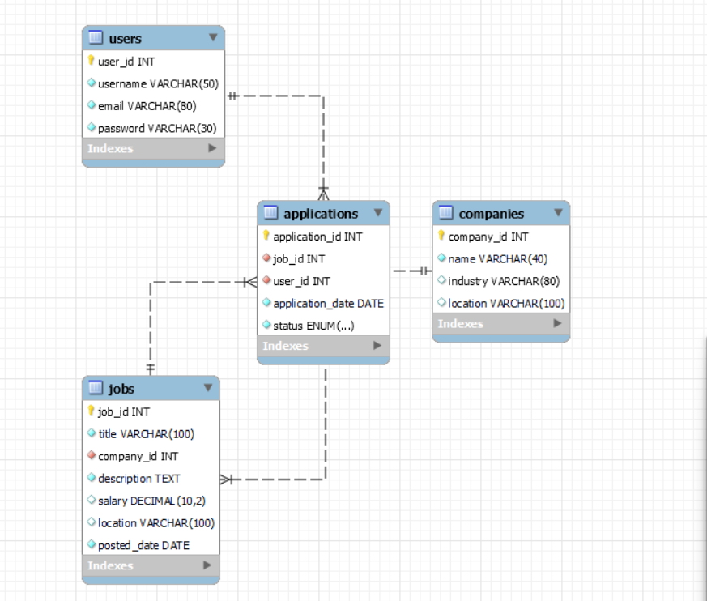
ER- DIAGRAM

Slide 4
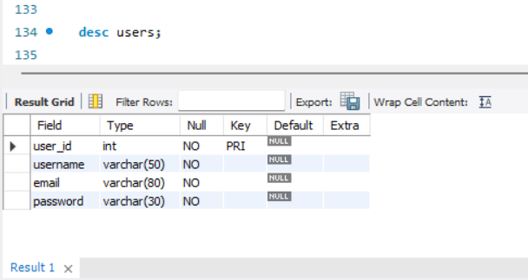
STRUCTURE OF TABLE
Users Table :
The Users table captures essential information about each user of the job search platform, including their identification details (username, email), login credentials (password), and registration information (registration date).
SYNTAX: DESC Users;

Slide 5
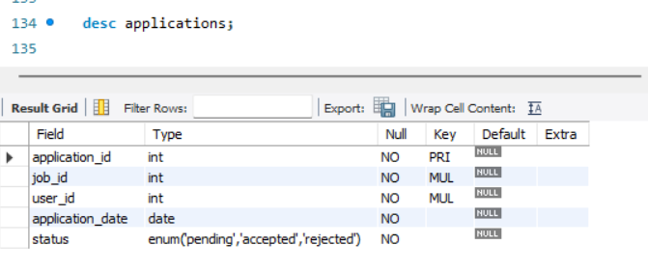
STRUCTURE OF TABLE
Applications Table
THIS TABLE SHOWS THE DETAILS USCH AS APPLICATION ID, JOB ID, USER ID, APPLICATION DATE , STATUS OF APPLICATION.
SYNTAX: DESC Applications;

Slide 6
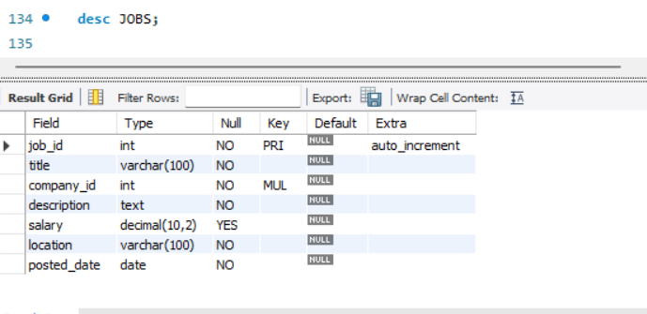
STRUCTURE OF TABLE
Jobs Table :
The Jobs table in the provided MySQL schema describes the available job positions within the job search platform. Each entry in this table represents a specific job opportunity posted by a company.
SYNTAX: DESC Jobs;

Slide 7
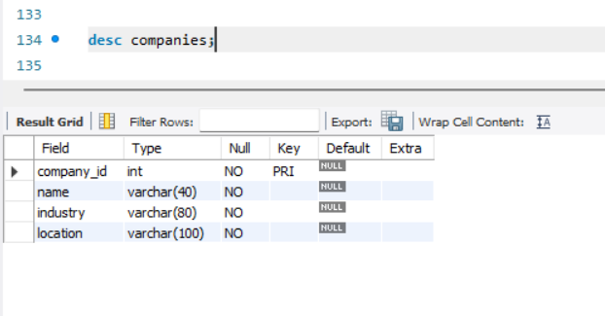
STRUCTURE OF TABLE
Companies Table :
The Companies table provides information about companies that are relevant to job seekers using the platform. It allows users to search for jobs by company name, location, or industry, providing context about the organizations behind the job listings.
SYNTAX: DESC Companies;

Slide 8
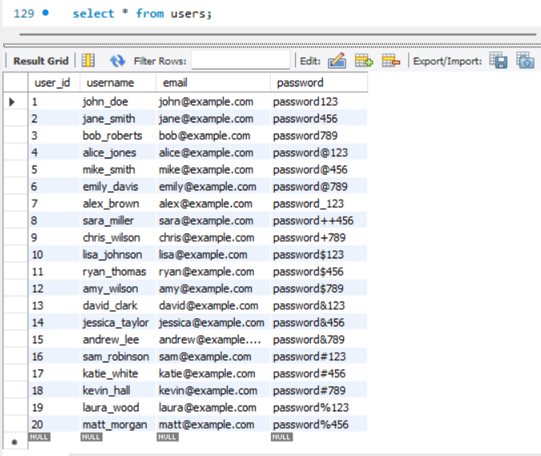
CONTENTS OF TABLE

Slide 9
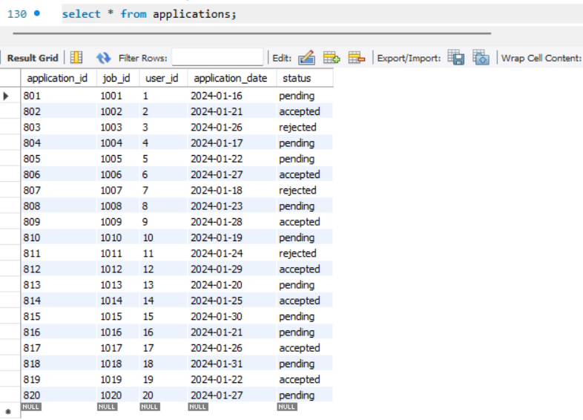
CONTENTS OF TABLE

Slide 10
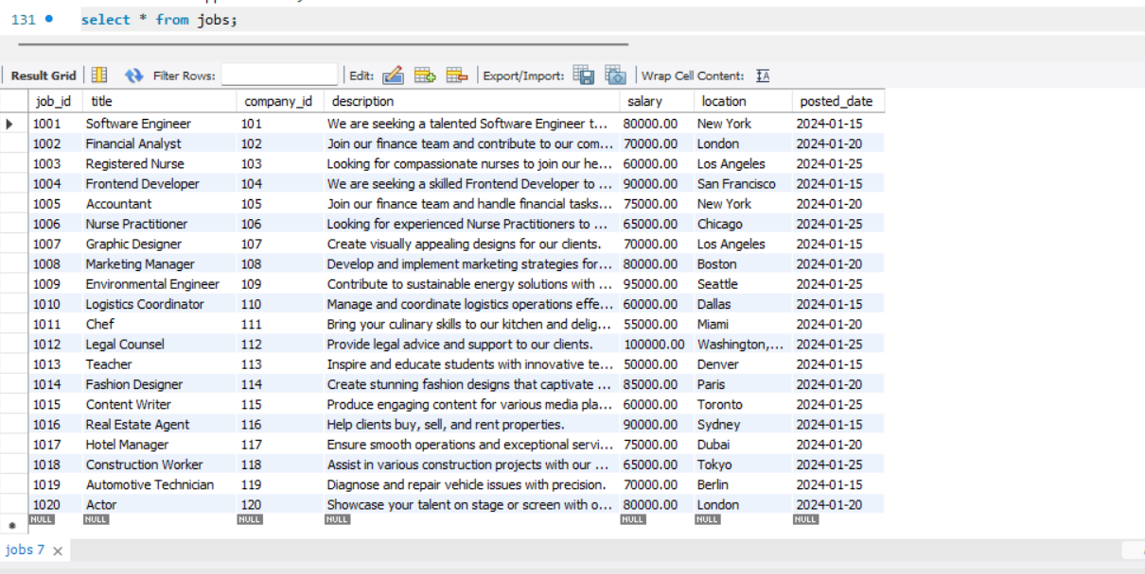
CONTENTS OF TABLE

Slide 11
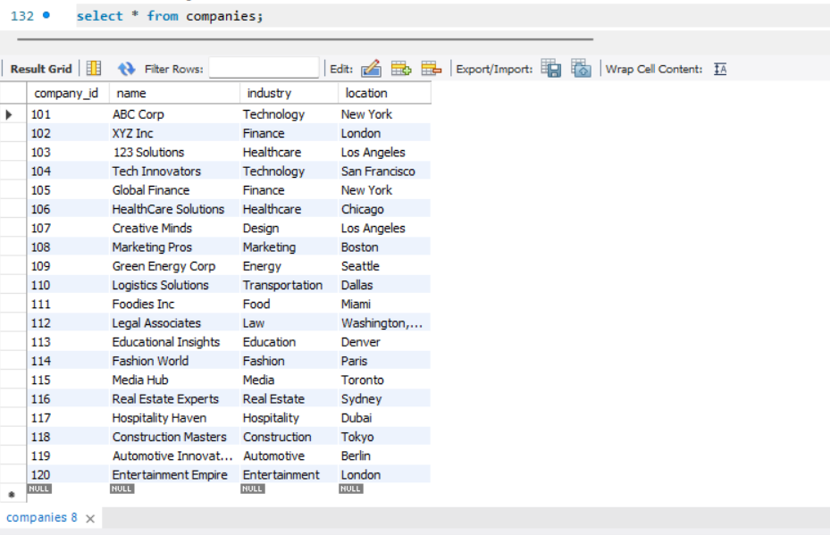
CONTENTS OF TABLE

Slide 12

SUB QUERIES

Slide 13
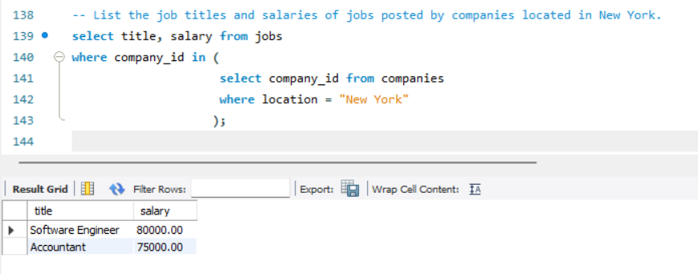
SUBQUERY
List the job titles and salaries of jobs posted by companies located in New York.
SYNTAX:
select title, salary
from jobs
where company_id in
(
select company_id
from companies
where location = "New York"
);

Slide 14
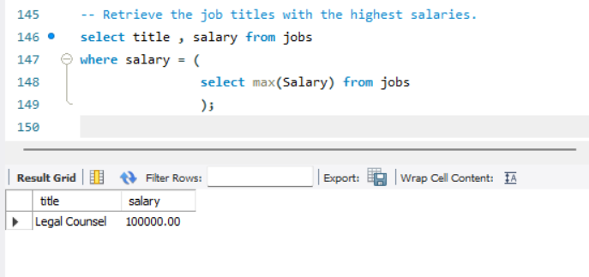
SUBQUERY
Retrieve the job titles with the highest salaries.
SYNTAX:
select title , salary
from jobs
where salary =
(
select max(Salary) from jobs );

Slide 15
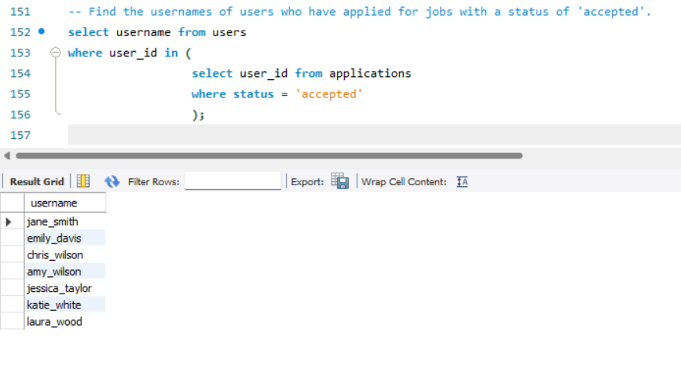
SUBQUERY
Find the usernames of users who have applied for jobs with a status of 'accepted'.
SYNTAX:
select username
from users
where user_id in
( select user_id from applications
where status = 'accepted' );

Slide 16
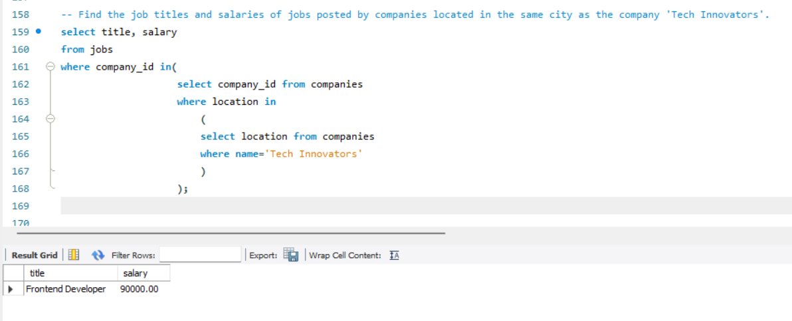
SUBQUERY
Find the job titles and salaries of jobs posted by companies located in the same city as the company 'Tech Innovators'.
SYNTAX:
select title, salary
from jobs where company_id in
(
select company_id from companies where location in
(
select location from companies where name='Tech Innovators' )
);

Slide 17

JOINS
This Photo
This Photo by Unknown Author is licensed under CC BY-SA

Slide 18
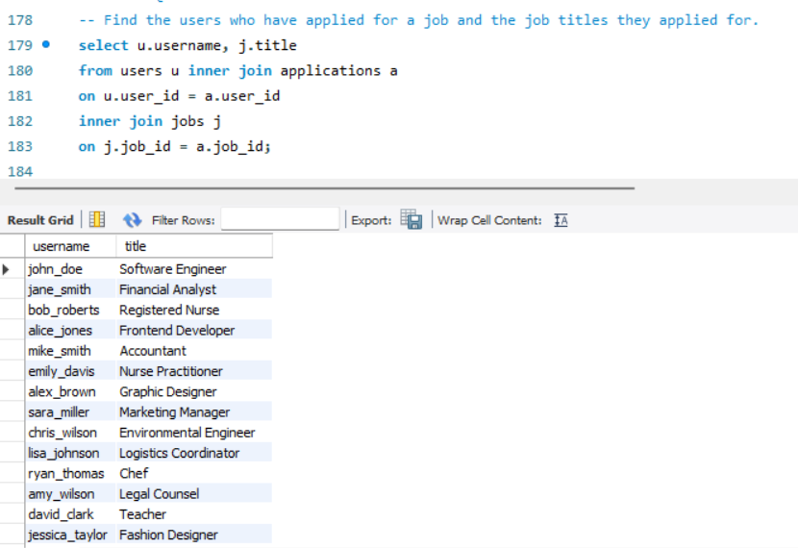
JOINS.
Find the users who have applied for a job and the job titles they applied for.
SYNTAX:
select u.username, j.title from users u inner join applications a
on u.user_id = a.user_id
inner join jobs j
on j.job_id = a.job_id;

Slide 19
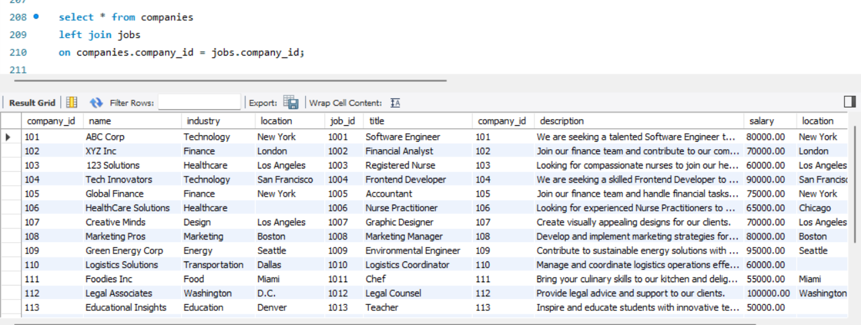
JOINS.
Left Join :
SYNTAX:
select * from
companies left join jobs
on companies.company_id = jobs.company_id;

Slide 20
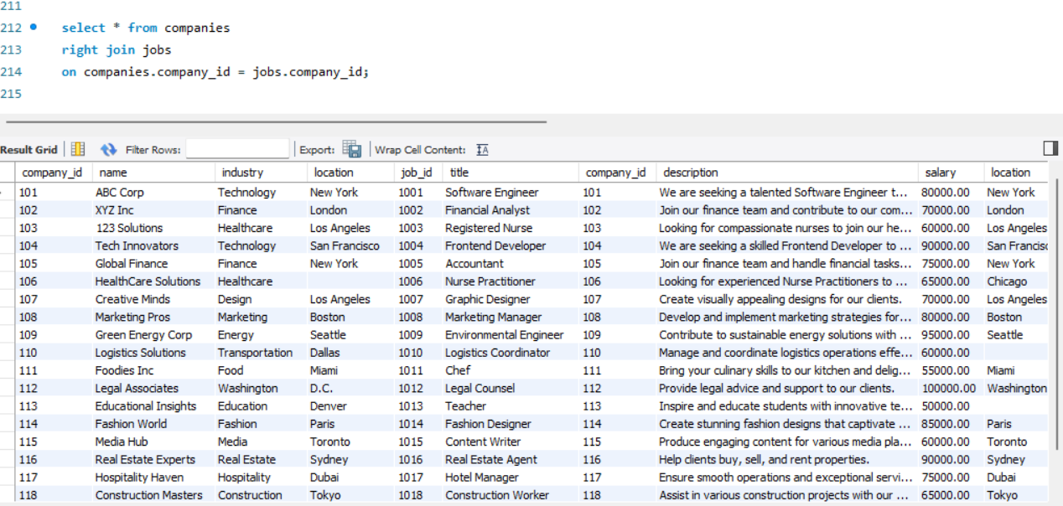
JOINS.
Right Join :
SYNTAX:
select * from
companies right join jobs
on companies.company_id = jobs.company_id;

Slide 21

VIEW

Slide 22
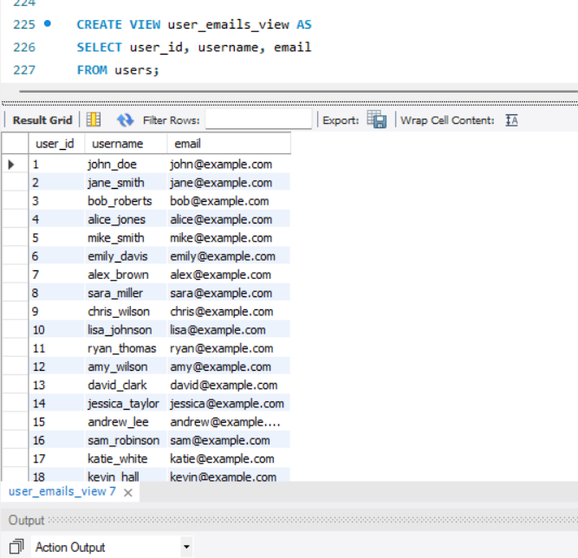
VIEWS.
CREATE VIEW AS users_emails_view.
SYNTAX:
create view
user_emails_view as
select user_id, username, email from users;

Slide 23
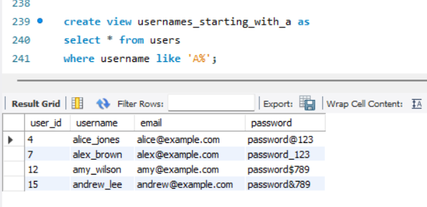
VIEWS.
CREATE VIEW AS usernames_starting_with_a.
SYNTAX:
create view usernames_starting_with_a as select * from users where username like 'A%';

Slide 24
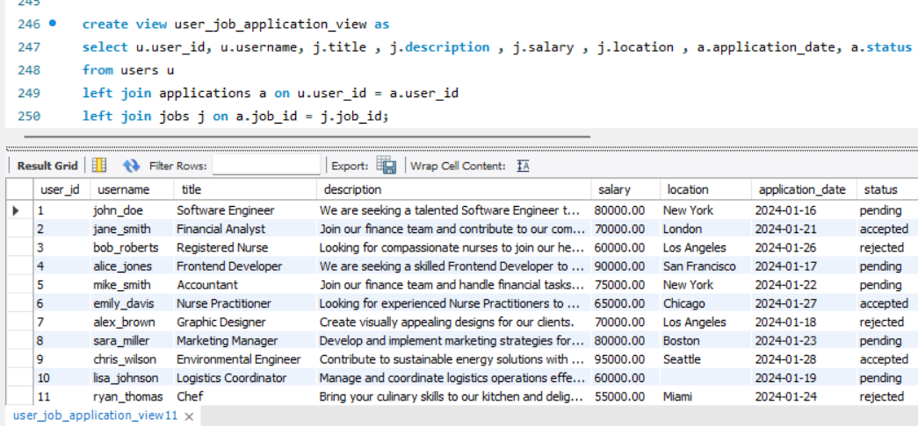
VIEWS.
CREATE VIEW AS user_job_application_view.
SYNTAX:
create view user_job_application_view asselect u.user_id, u.username, j.title , j.description , j.salary , j.location , a.application_date, a.statusfrom users uleft join applications a on u.user_id = a.user_idleft join jobs j on a.job_id = j.job_id;

Slide 25

PREPARED BY :
Siddhant Shivaji Gaikwad
IT VEDANT
Nov23 – T313/DS/PS/11-1PM

Slide 26







THANK YOU
This Photo by Unknown Author is licensed under CC BY
This Photo by Unknown Author is licensed under CC BY-SA-NC

